Slide 1

Revolutionizing Supply Chain Traceability: Leveraging Blockchain Technology to Enhance Transparency and Mitigate the Risk of Fraud and Counterfeit Products

Slide 2
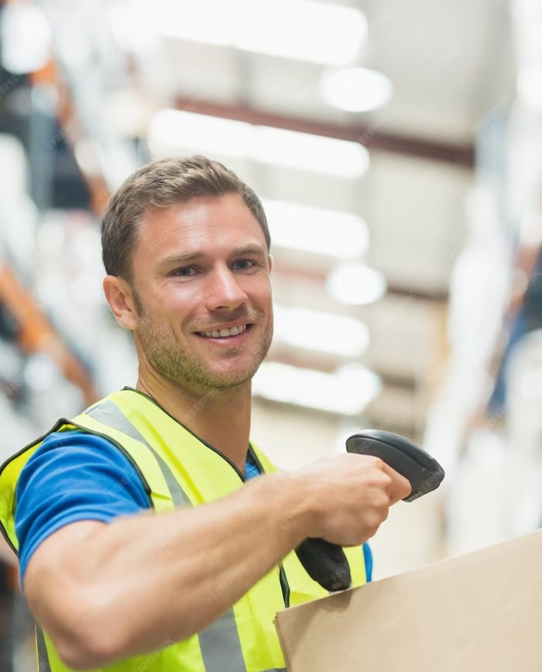
Introduction
Supply chain traceability is a critical aspect of modern business operations. Blockchain technology offers a secure and transparent way to track products from origin to destination, reducing the risk of fraud and counterfeit products. This presentation will explore how blockchain can revolutionize supply chain traceability.

Slide 3

What is Blockchain?
Blockchain is a distributed ledger technology that allows for secure and transparent transactions. Each block in the chain contains a cryptographic hash of the previous block, creating an unbreakable chain of data. This technology is ideal for supply chain traceability because it ensures that all parties have access to the same information.

Slide 4
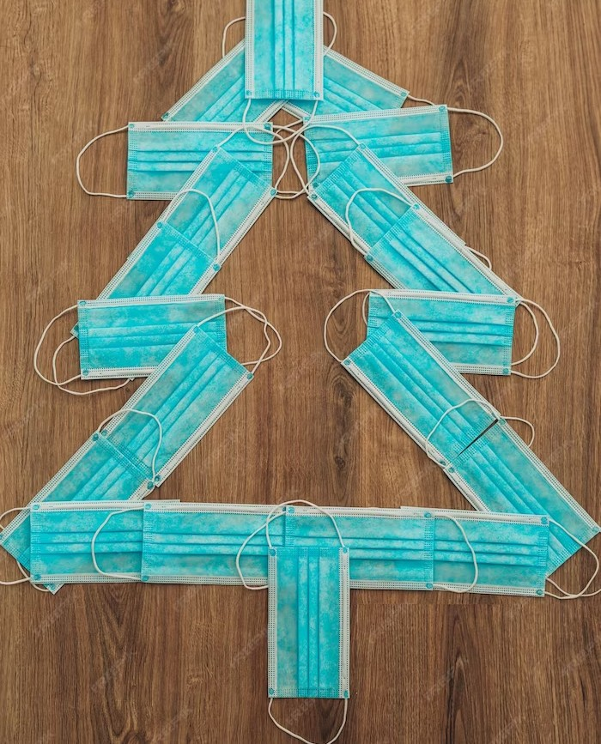
The Problem with Traditional Supply Chain Traceability
Traditional supply chain traceability methods are often paper-based and rely on trust between parties. This can lead to errors and discrepancies in the supply chain. Additionally, it can be difﬁcult to trace products back to their origin, making it challenging to identify the source of any issues.
Blockchain technology can solve these problems by providing a secure and transparent way to track products.

Slide 5

How Blockchain Enhances Supply Chain Traceability
Blockchain technology allows for the creation of a secure and transparent ledger that all parties can access. This ensures that everyone has access to the same information and reduces the risk of errors and discrepancies. Additionally, the immutable nature of the blockchain means that it is easy to trace products back to their origin, making it easier to identify the source of any issues.

Slide 6

Real-World Applications of Blockchain in
Supply Chain Traceability
Blockchain technology is already being used in a variety of industries to enhance supply chain traceability. For example, Walmart is using blockchain to track the origin of its food products, while IBM is using blockchain to track the origin of minerals used in electronic devices. These applications demonstrate the potential of blockchain to revolutionize supply
chain traceability.

Slide 7

Beneﬁts of Blockchain in Supply Chain Traceability
Blockchain technology offers a number of beneﬁts for supply chain traceability, including increased transparency, improved efﬁciency, and reduced risk of fraud and counterfeit products.
Additionally, blockchain can help to build trust between parties by
providing a secure and transparent way to track products.

Slide 8

Challenges of Implementing Blockchain in Supply Chain Traceability
While blockchain technology offers many beneﬁts for supply chain traceability, there are also challenges to implementing this technology.
These challenges include the need for standardization, the cost of implementation, and the need for collaboration between different parties in the supply chain. However, with proper planning and collaboration, these challenges can be overcome.

Slide 9
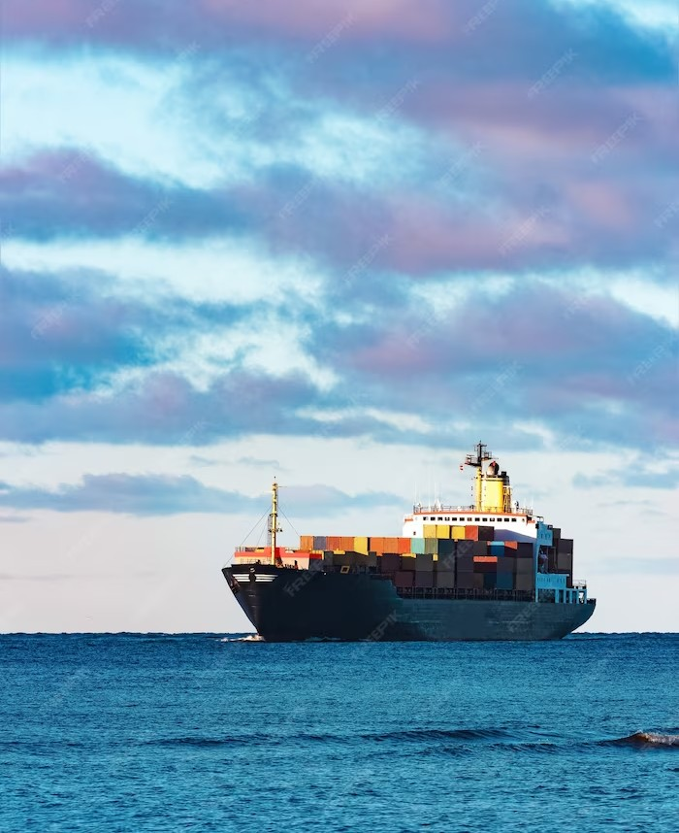
Case Study: Maersk and IBM's TradeLens Platform
Maersk and IBM have developed a blockchain-based platform called TradeLens to enhance supply chain traceability in the shipping industry. This platform allows for the secure and transparent tracking of shipping containers from origin to destination, reducing the risk of errors and delays. The TradeLens platform demonstrates the potential of blockchain to revolutionize supply chain traceability.

Slide 10

Future of Supply Chain Traceability with Blockchain
The future of supply chain traceability looks bright with the use of blockchain technology. As more industries adopt blockchain, we can expect to see increased transparency, improved efﬁciency, and reduced risk of fraud and counterfeit products. Additionally, blockchain can help to build trust between parties in the supply chain, leading to more collaboration and innovation.

Slide 11
Conclusion
Blockchain technology offers a secure and transparent way to track products in the supply chain, reducing the risk of fraud and counterfeit products. While there are challenges to implementing this technology, the beneﬁts are signiﬁcant. As more industries adopt blockchain, we can expect to see increased transparency, improved efﬁciency, and reduced risk of errors and delays.

Slide 12
Thanks!
BY ABHISHEK PANDEY

